Slide 1


Proprietary Software Vs. Free Open Source Software CSI 221 Computer Ethics and Society
AMERICAN UNIVERSITY OF SCIENCE & TECHNOLOGY
Presented by:
)
Yaakoub Khalil (12200055)
Submitted to:
dr. DAVID KHOURY

Slide 2
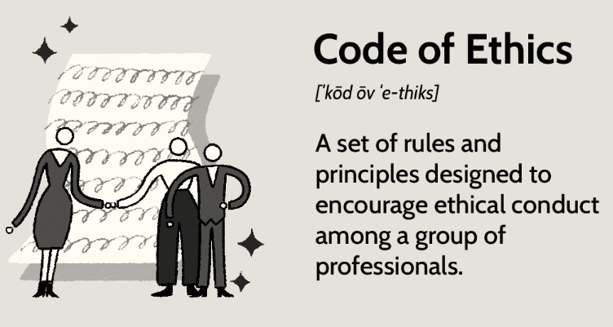
Ethics standards and codes
Ethical standards
refer to a set of values that the institution's founders developed to guide the organization's conduct.
CSI 221 - Computer Ethics and Society

Slide 3

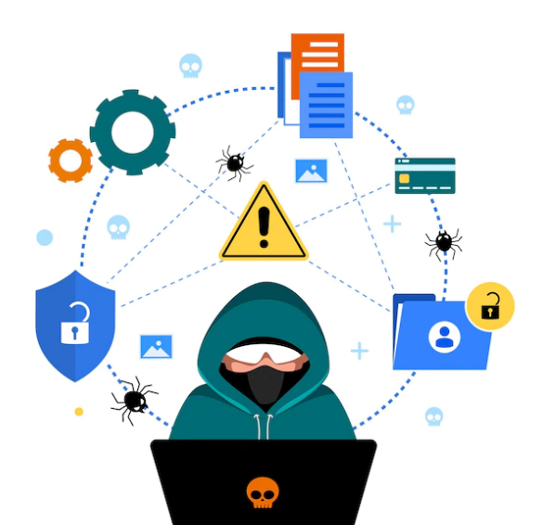
Ethics Values - Law
Ethics deals with placing a “value” on acts according to whether they are “good” or “bad”. Every society has its rules about whether certain acts are ethical or not. These rules have been established as a result of consensus in society and are often written into laws.
Computer crimes and computer fraud are now common terms. There are laws against them, and everyone is responsible for knowing what constitutes computer crime and computer fraud.
CSI 221 - Computer Ethics and Society

Slide 4

Computer Ethics
Ten Commandments of Computer Ethics
Thou shalt not use a computer to harm other people.
Thou shalt not interfere with other people's computer work.
Thou shalt not snoop around in other people's computer files.
Thou shalt not use a computer to steal.
Thou shalt not use a computer to bear false witness.
Thou shalt not copy or use proprietary software for which you have not paid (without permission).
CSI 221 - Computer Ethics and Society

Slide 5
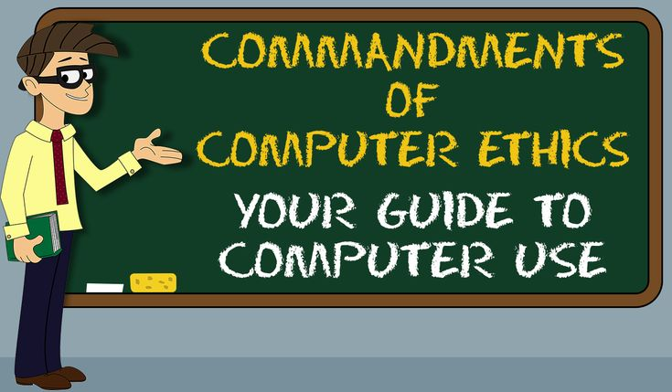
Computer Ethics
Ten Commandments of Computer Ethics
Thou shalt not use other people's computer resources without authorization or proper compensation.
Thou shalt not appropriate other people's intellectual output.
Thou shalt think about the social consequences of the program you are writing or the system you are designing.
Thou shalt always use a computer in ways that ensure consideration and respect for other humans.
CSI 221 - Computer Ethics and Society

Slide 6
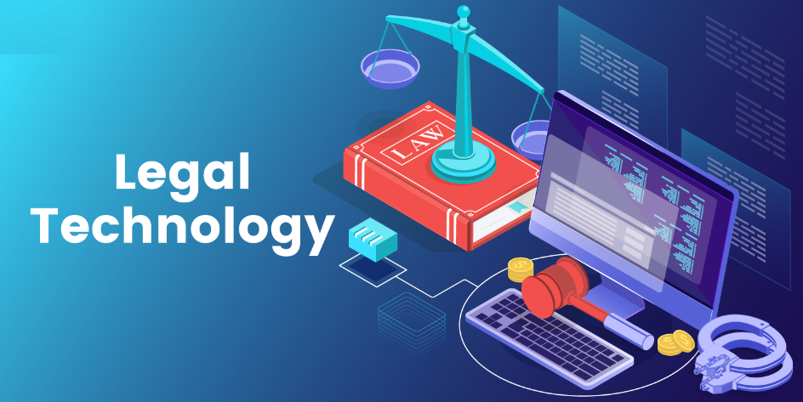
Computer Ethics
Some Details
If it is unethical to harm people by stealing and destroying other people’s property, ex: books and notebooks, it is equally bad to access and destroy their files.
Copying somebody else's program without proper authorization is software piracy and is unethical.
Reading other people’s e-mail messages is as bad as opening and reading their letters: This is invading their privacy.
Using a computer to break into the accounts of a company or a bank and transferring money should be judged the same way as robbery.
CSI 221 - Computer Ethics and Society

Slide 7
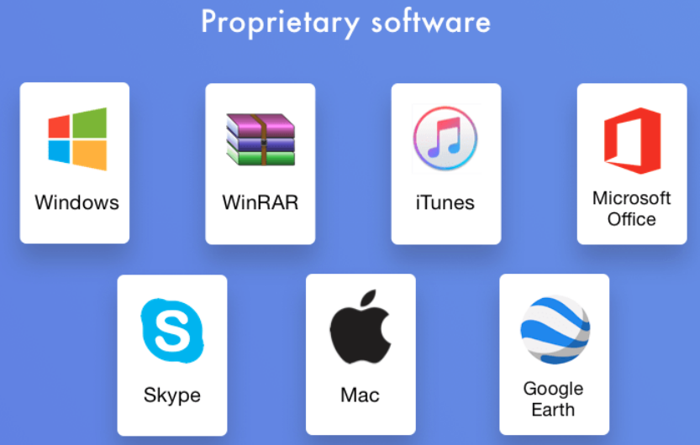
Proprietary Software (PS)
A software that is owned by a specific person or organization.
Is protected by copyright laws.
Is not publicly available for users to modify or distribute.
Users may be required to pay a fee to use it. One time or by timely subscription.
CSI 221 - Computer Ethics and Society

Slide 8

Free open-Source Software Definition (FOSS)
A software that is available for anyone to use, modify, and distribute.
It is developed by a community of volunteers and the source code is publicly available.
Is often distributed under a license that allows users to freely use, modify, and distribute the software, as long as they follow specific terms.
Examples:
The Linux operating system.
The Apache web server.
The LibreOffice productivity suite.
CSI 221 - Computer Ethics and Society

Slide 9

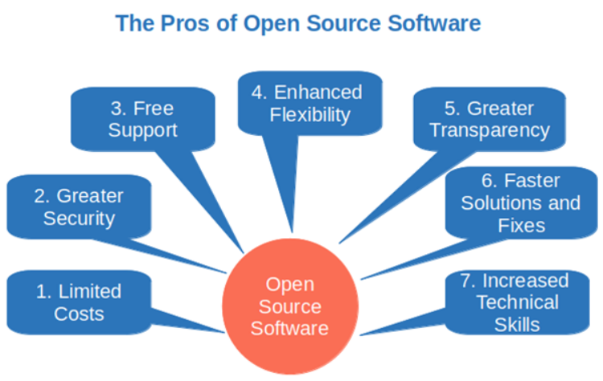
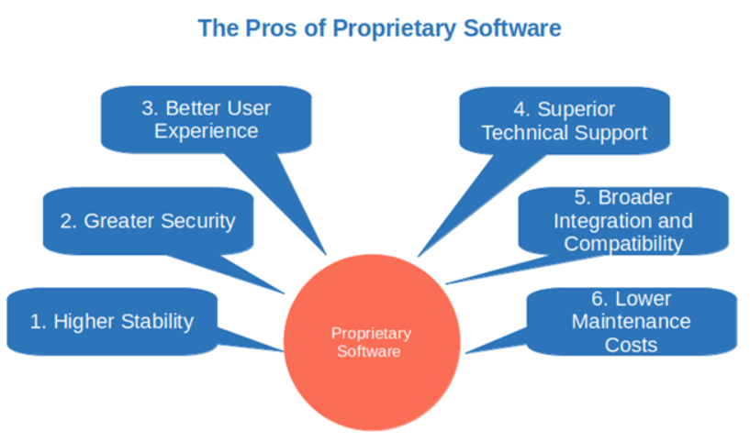


Rivalry
Free Open Source
Proprietary
CSI 221 - Computer Ethics and Society
Notes:
Bespoke solutions = custom made for specific requirements / clients needs

Slide 10
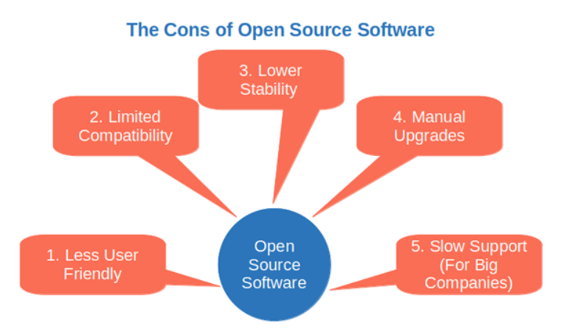
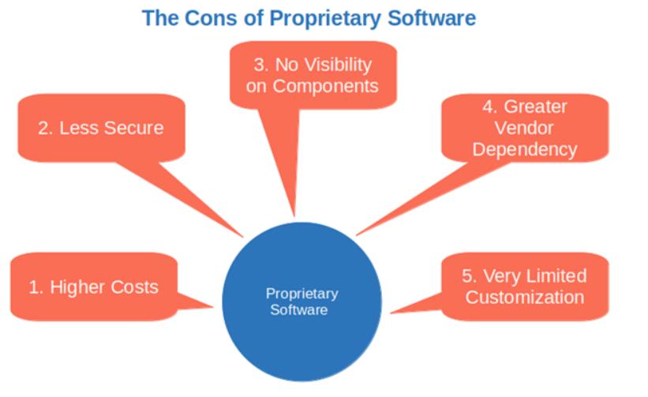

Rivalry
Free Open Source
Proprietary
CSI 221 - Computer Ethics and Society

Slide 11
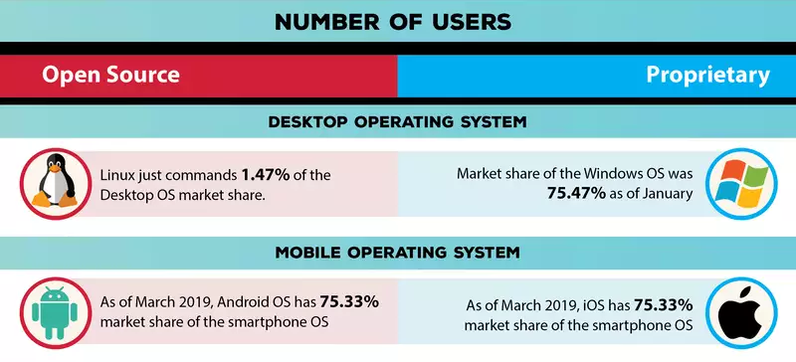
Market Share
CSI 221 - Computer Ethics and Society

Slide 12
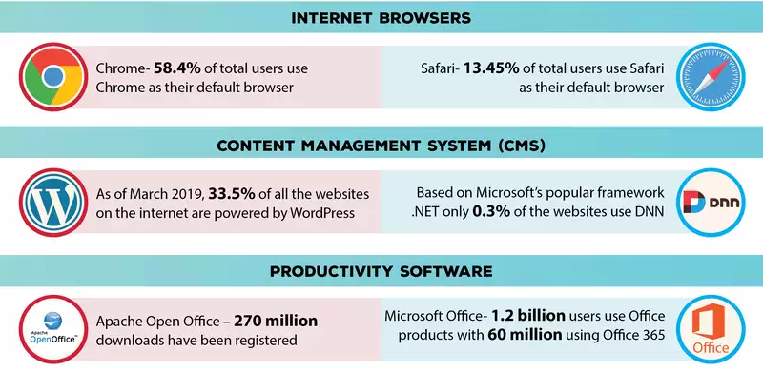
Market Share
CSI 221 - Computer Ethics and Society

Slide 13

Ethics?
Free Open Source
Key roles:
Commercial Consumer & Redistributor
Open Source Provider
Open Source Contributors: success
Respect: provider’s ideas and rights
Moral: community to give back
Compliance and Trust: no usage abuse
CSI 221 - Computer Ethics and Society

Slide 14
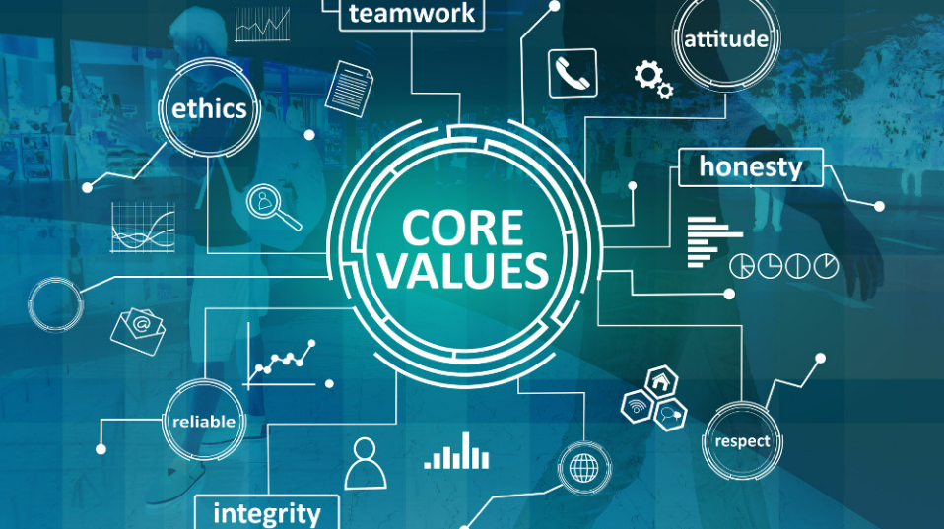
Ethics?
Free Open Source - Conclusion
Open source is generally perceived to be ethical because of the freedoms that it promotes. However, just because a solution is positioned as open source, does not necessarily mean it is an ethical.
Must meet the obligations of open source licensing and respect the intellectual property of the developers and organizations that have contributed code for re-use.
https://sourcecodecontrol.co/ethics-of-open-source-licensing/
CSI 221 - Computer Ethics and Society

Slide 15

Ethics?
Proprietary Software Classification
In terms of copyright, there are four broad classifications of software:
Commercial: covered by copyright, acquiring a license to use it, not own it.
Shareware: allow purchasers to make and distribute copies of the software
Freeware: cannot take FREEWARE, modify or extend it, and then sell it as COMMERCIAL or SHAREWARE software.
CSI 221 - Computer Ethics and Society

Slide 16
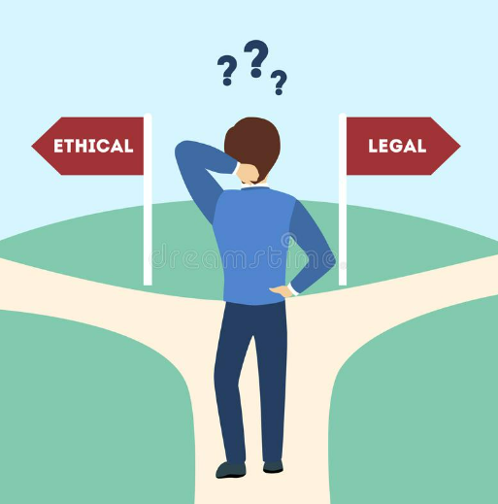
Ethics?
Proprietary Software
Licenses:
License is permission granted by the holder of a copyright to another to use an original work.
EULA: End User License Agreement.
GPL and LGPL
CSI 221 - Computer Ethics and Society

Slide 17
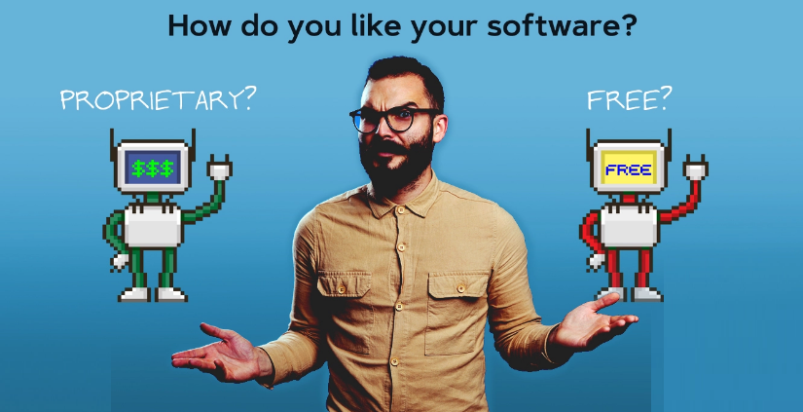
And the debate stays on?
CSI 221 - Computer Ethics and Society

Slide 18
Thank You!
_____________________
CSI 221 - Computer Ethics and Society

Slide 19
References:
https://codesigningstore.com/open-source-vs-proprietary
https://content.techgig.com/infographics/a-comparison-between-open-source-and-proprietary-software/articleshow/68985640.cms
https://www.xiphcyber.com/articles/open-source-vs-proprietary-software
https://en.wikipedia.org/wiki/Ten_Commandments_of_Computer_Ethics
https://wustl.edu/about/compliance-policies/computers-internet-policies/legal-ethical-software-use/
https://www.cmpe.boun.edu.tr/~say/c150/intro/lit10.html#:~:text=8)%20Thou%20shalt%20not%20appropriate,software%20piracy%20and%20is%20unethical.
Google search engine and images
CSI 221 - Computer Ethics and Society

